Slide 1
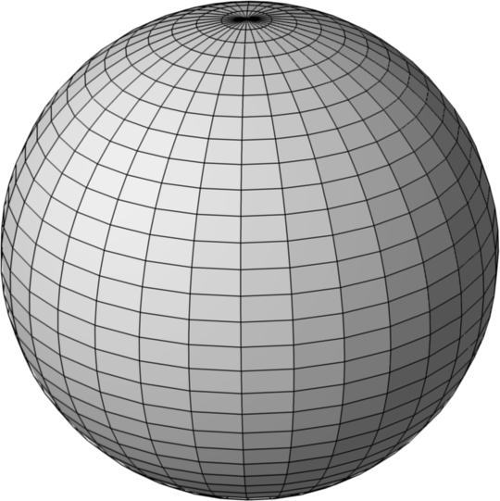
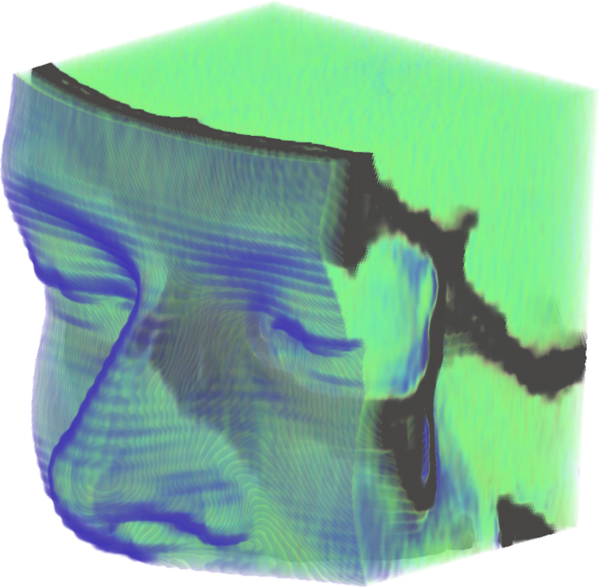
Computer Graphics
3D Object Representations

Slide 2
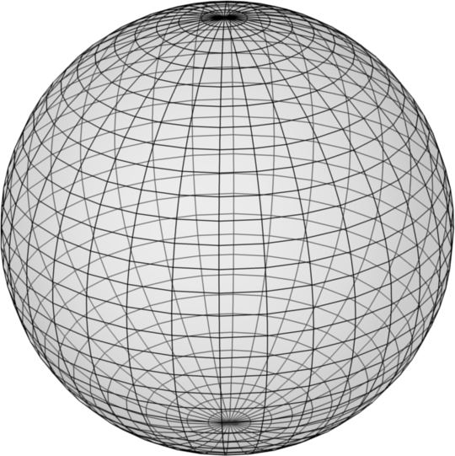
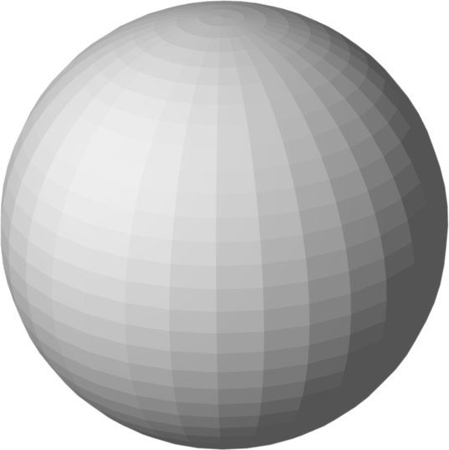

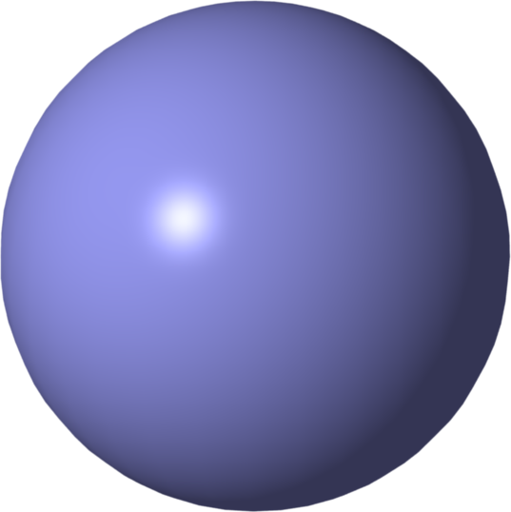
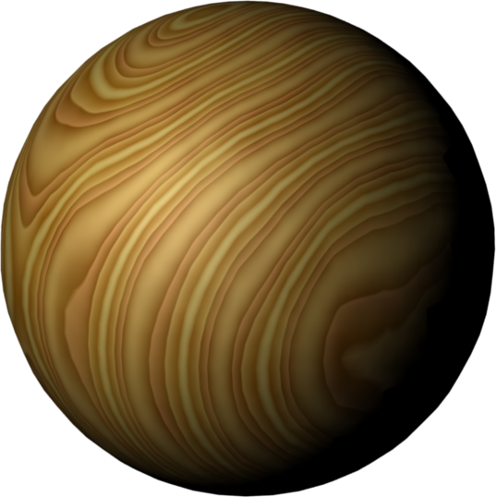
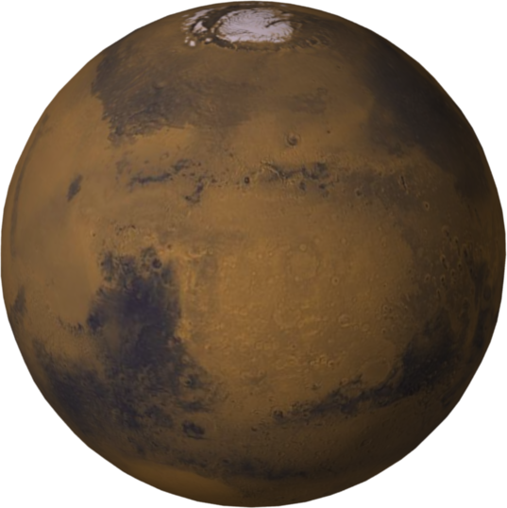
What to Specify for a 3D Shape?
geometry
spatial positions
connectivity, inside/outside
material properties
light reflectance & texture (plastic, wood, metal, etc.)
other material properties (elasticity, mass, etc.)
behavior/animation
more depending on specific applications

Slide 3
How to Specify a 3D Geometry?
boundary representations (b-reps)
meshes
(piecewise linear approximations)
volume representations
voxel models
implicit surfaces
constructive solid geometry (CSG)
space partitioning
octrees
binary space partitioning (BSP) trees

Slide 4
B-Reps: Piecewise-Linear Surfaces
polygons define the surface of objects
triangle meshes
polygon with fewest vertices
always convex & planar
triangle strips:
faster, more compact
more complex structures
winged edge

Slide 5

B-Reps: Piecewise Smooth Surfaces
surface constructed from patches
patches can be curved
higher-order smoothness across edges than polygons
examples: Bézier, spline, NURBS surfaces

Slide 6
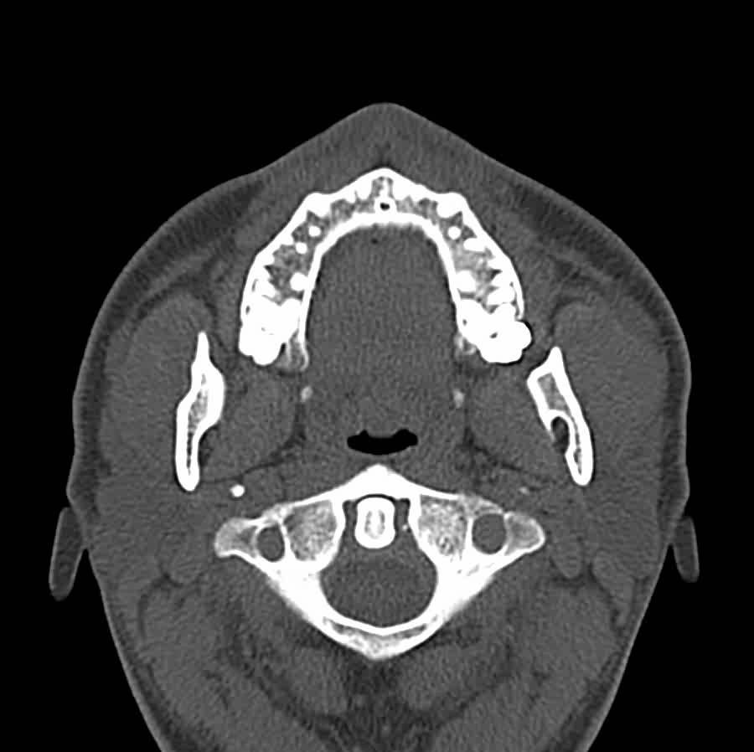
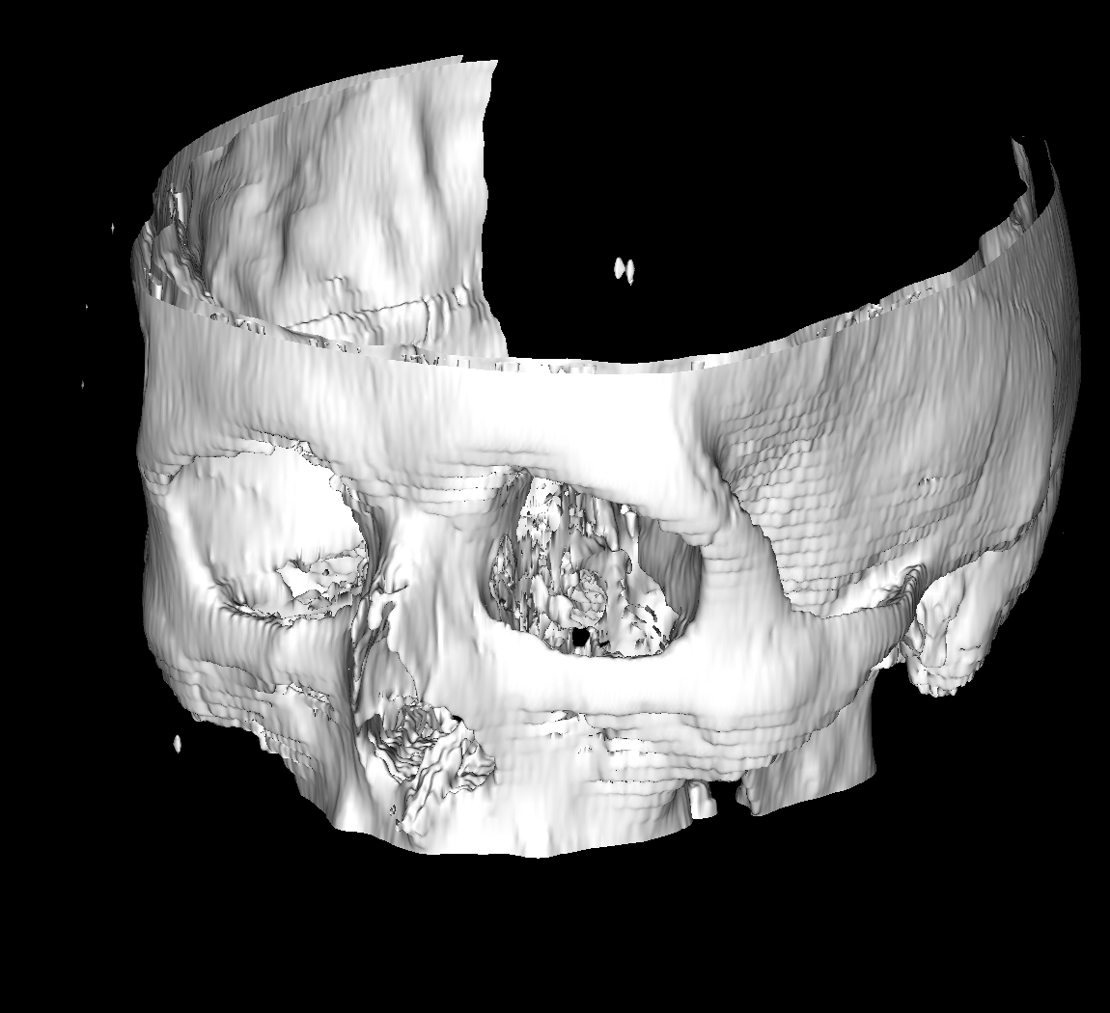
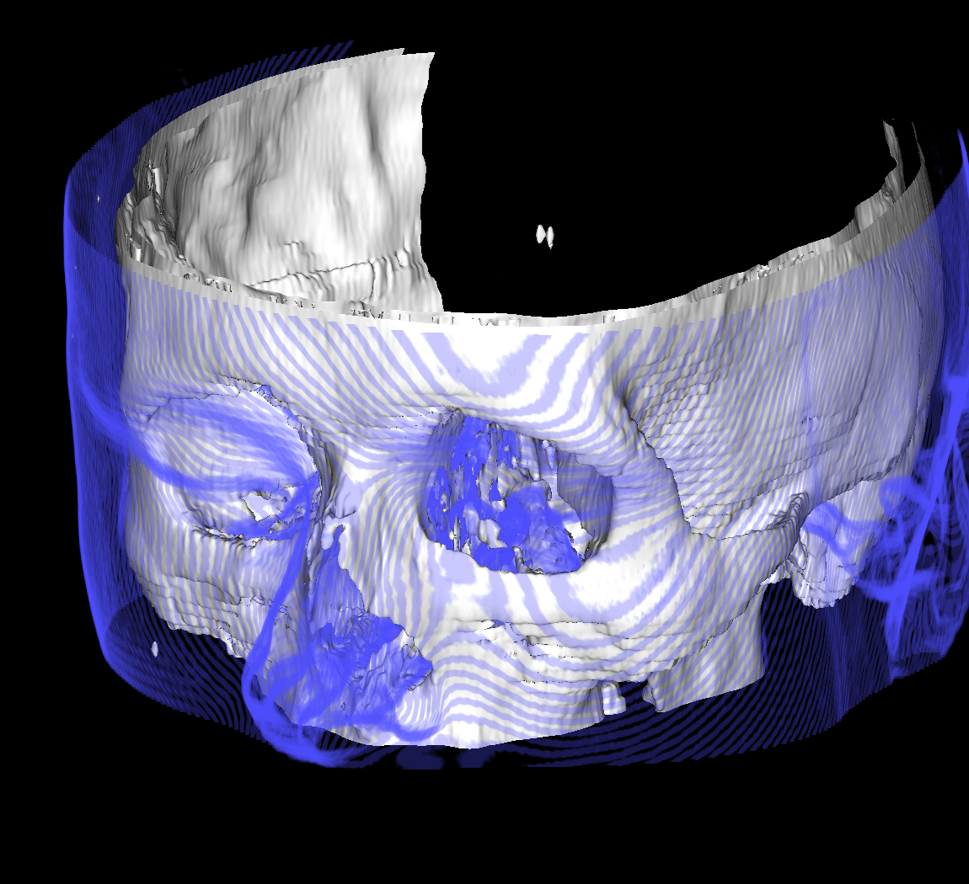
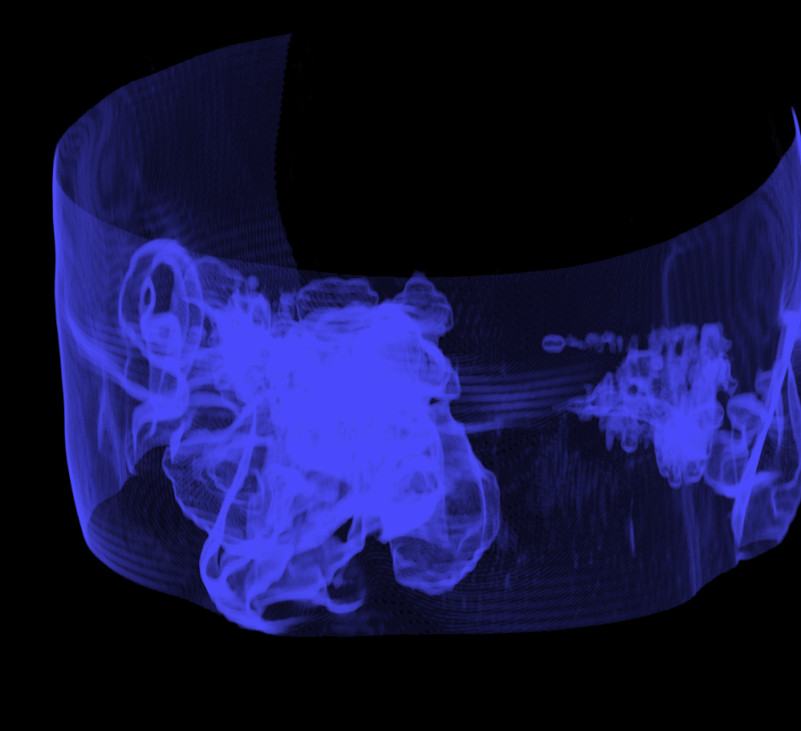
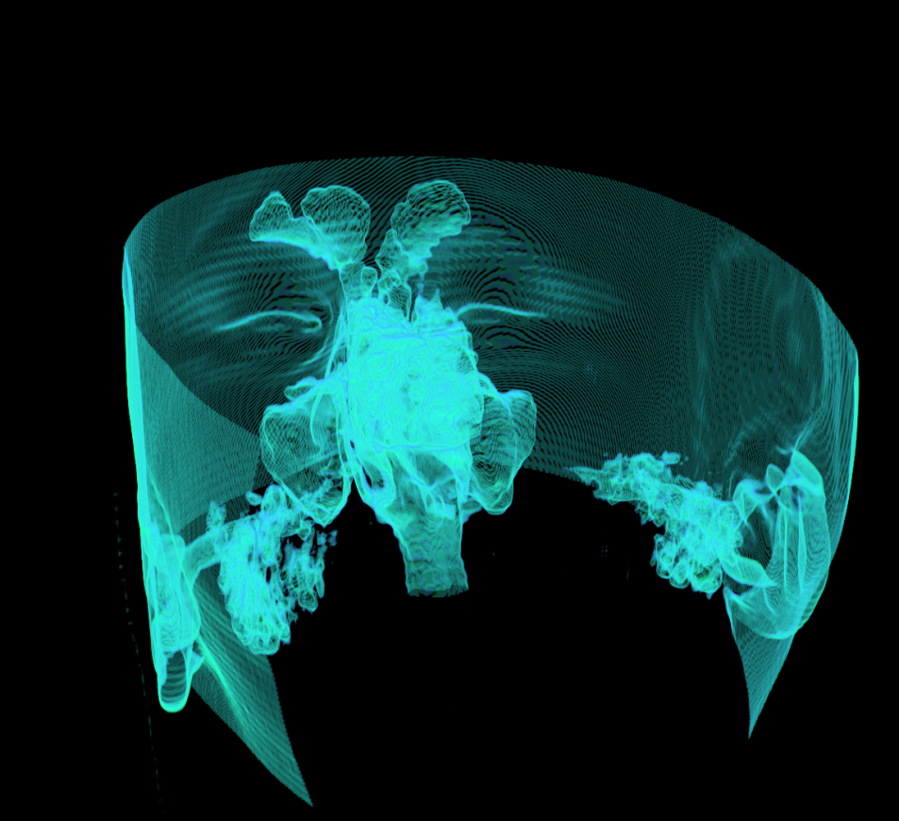
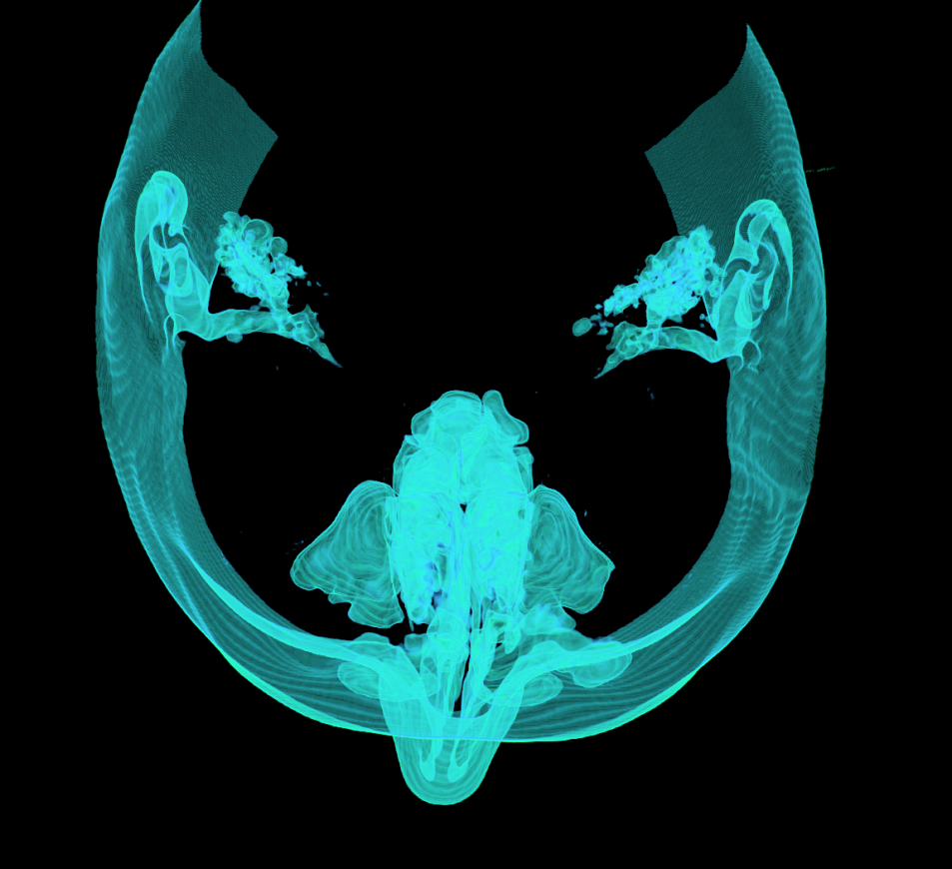
Volumes: Voxel Models
uniform sampling of a volume (not surface)
samples = cubes
represent an entire 3D space, not just a surface!

Slide 7
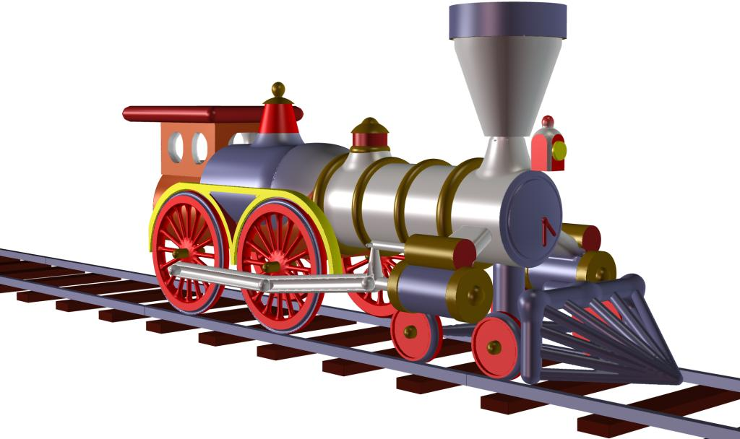
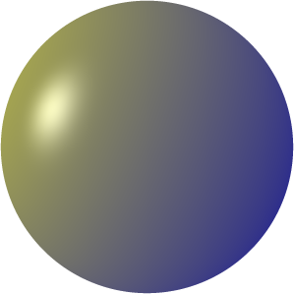
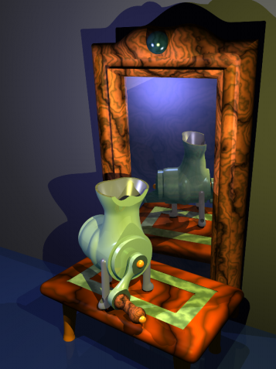
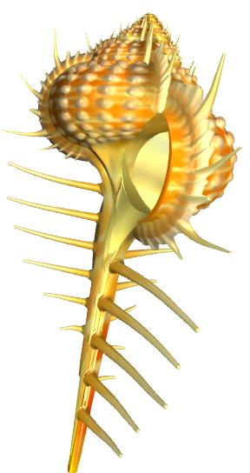
Volumes: Implicit Surfaces
surface = solution of an equation in 3D
iso-values define boundary & inside
advantage: compact modeling!
y
iso-surface
r
x
z
iso-value
images courtesy of Brian Wyvill et al.

Slide 8
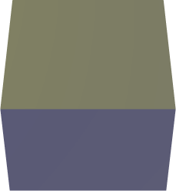
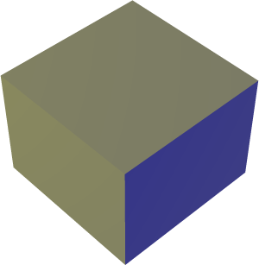
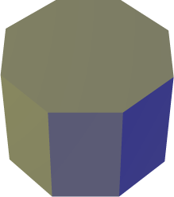
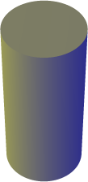
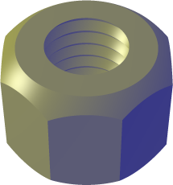
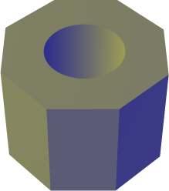
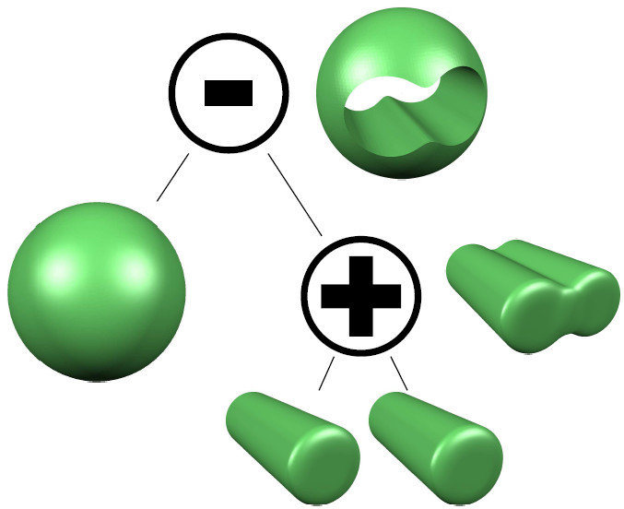
Constructive Solid Geometry (CSG)
Boolean operators to combine shapes
unions, intersections, set differences
combine simple implicit functions to complex results
build up CSG trees
∩
–

Slide 9
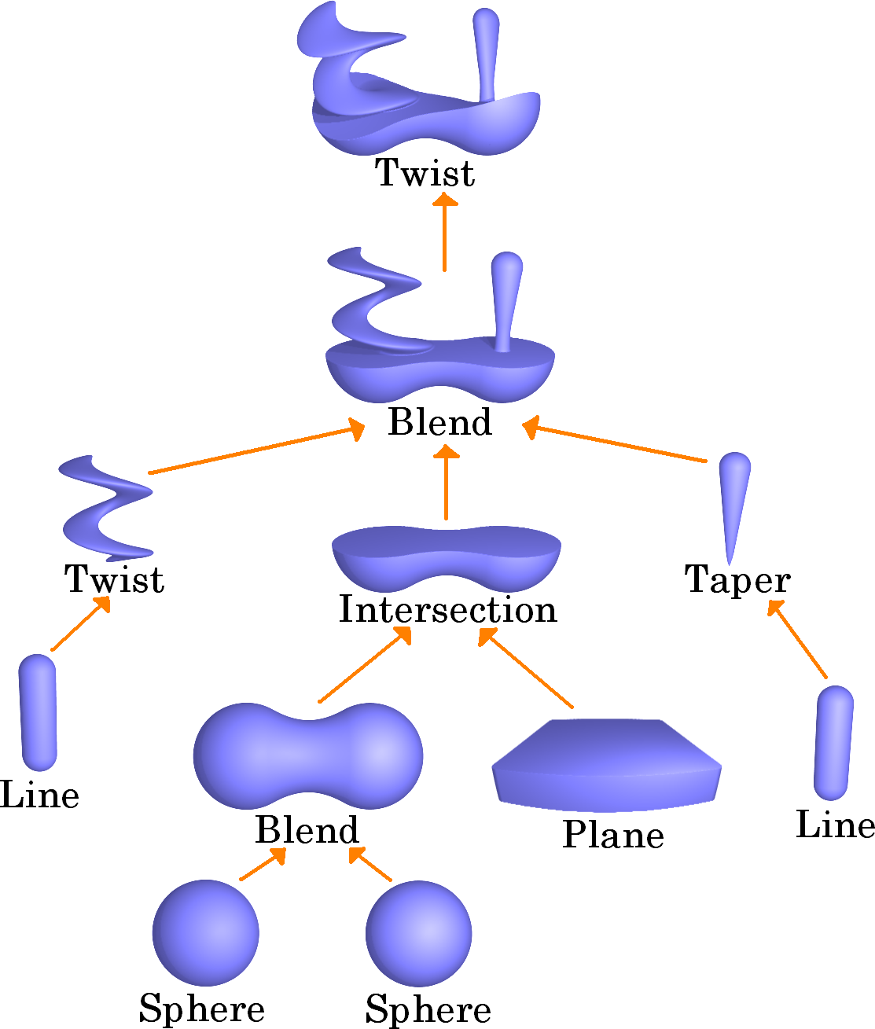
Implicit Surface CSG Trees: Blobtree
courtesy of Erwin de Groot and Brian Wyvill

Slide 10
BSP trees and Octrees
space partitioning: define sub-spaces
Binary Space Partitioning: half-spaces
planes define borders between inside and outside
combine planes into hierarchy
octrees: partitioning on regular grids
mark cells as inside, outside, or subdivide
2D case: quadtrees

